Slide 1
What is Commerce
I want to open a bakery

Slide 2
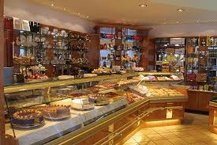
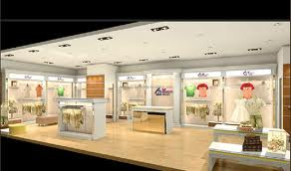
What should I do?
I need a company who can
build my bakery.

Slide 3
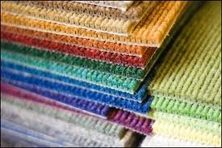
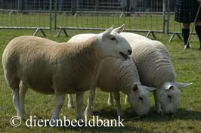
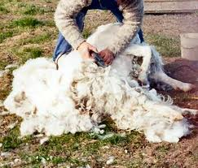
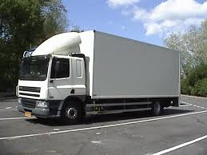
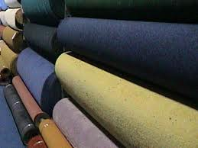
I need carpeting
The carpet is made of wool.
Sheep deliver the wool.
The sheep have to be clipped.
The wool has to be transported to the floor factory.

Slide 4
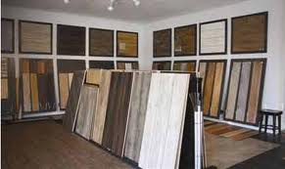
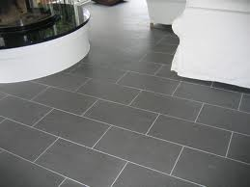
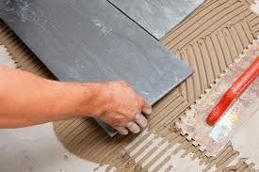
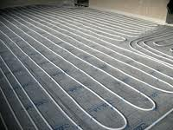
I need a floor in the entrance
I might choose to have a Polyester carpet. That is made from oil.
I might choose stones.
Those stones are cut somewhere and polished, transported to my shop and the tile layer sets the floor.
I might prefer floor heating and have to organize that too.

Slide 5
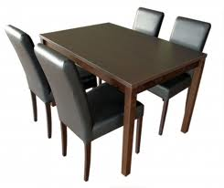
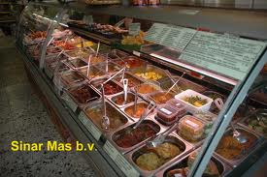
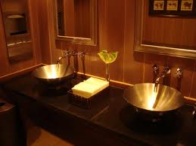
I need furniture
All the things I need to get my backery as I want it to be, need to come from some place. Someone made it and someone will bring it to me.

Slide 6
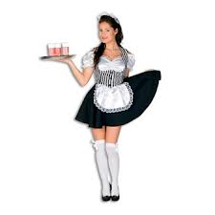
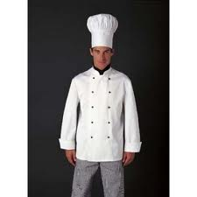
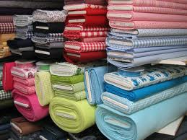
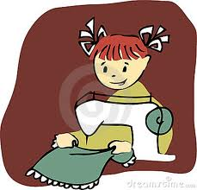
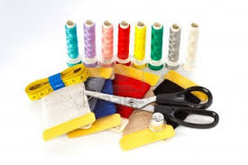
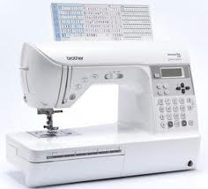
I need professional working clothing
To make those clothing the once who make them need Material, thread a sewing machine and a seamstress…
I remember the name of the seamstress, for my daughter wants to marry and she might need a wedding dress made by her….

Slide 7

I need to make a Website
I remember that the carpenter told me that he had a guy who made his website and I go to him for my website.
Now this Web designer is also a member of the CLUB and will have orders for a website from different countries, because he recognized the value of the SPURT and people can pay him in SPURT, as they will be able to pay me in SPURT.

Slide 8
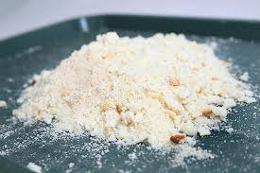
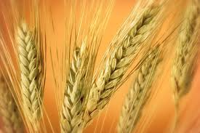
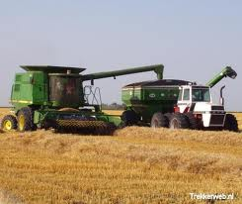
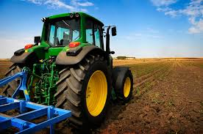
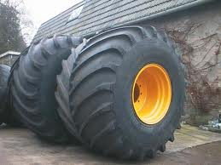
I need oat
Corn has to grow and must be harvested.
The farmer will need a tractor.
This will need new tires one day.

Slide 9
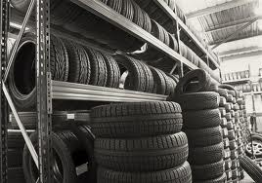
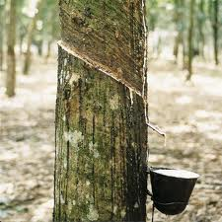
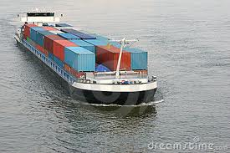
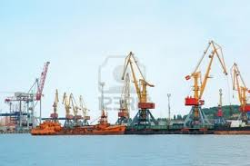
The tires has to be bought in a Wholesale company
Those tires are made of rubber that not only needs to be harvested, but als need to be shipped.
The harbor is giving a lot of people a job.

Slide 10
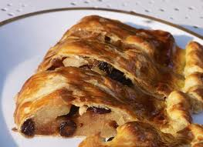
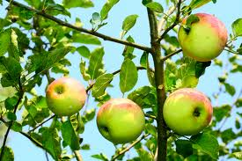
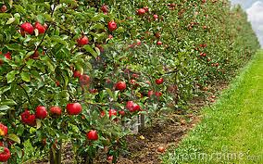
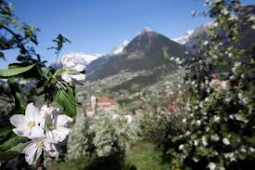
I want to bake an apple pie
I do not only need oat, but also apples. Those Apple trees have nice blossom and during the time they blossom, many tourists are coming to those places to enjoy this.
Hotels are full and all bakeries in the surrounding profit in this area.

Slide 11
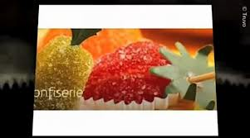
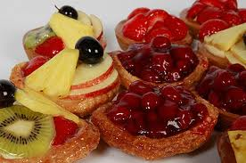
I want to add other fruit
Somewhere someone is finding a job to be able for me to get the fruit delivered.

Slide 12
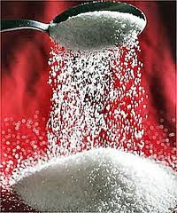
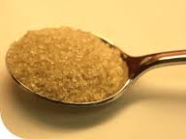
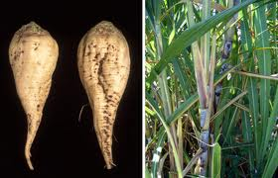
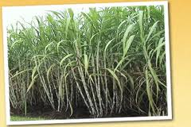
I need sugar
White sugar or raw sugar
Sugar plants offer a lot of work and I can, because I work within the CLUB and already work with ship companies and freighters, work with the ones I used for the Rubber already.

Slide 13
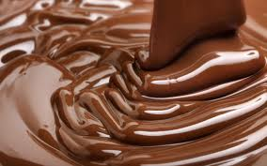
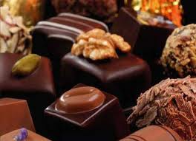
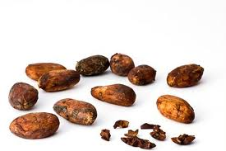
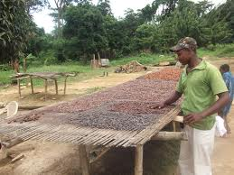

I need chocolate
Because I want to make high quality bonbon, I look for the best chocolate I can get and take care that it is Fair Trade. I can assure that the workers are well paid through „I offer a job“.

Slide 14
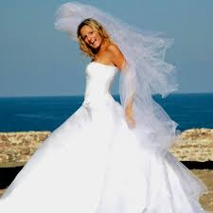


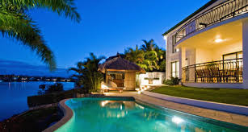
Finally the day has come that all is ready and my daughter gets married.
The seamstress I know already is sewing the dress and I pay for it with SPURT. Her honeymoon trip will start with a flight with the airplane company I contracted for the CLUB while flying to the country where I buy my chocolate. I need not tell that all will be paid for with SPURT, for all are members of the CLUB.
In the country where I bought the chocolate the beaches are so beautiful and the hotel I stayed was so gorgeous, that I arranged for her and her husband to be here for 14 days. All are CLUB members since my last visit and that is why all this was paid with SPURT.

Slide 15



Each business we worked with are now members of the CLUB and each of them is paying with SPURT
All can subscribe to MySPURT so that also others know what they have to offer.
All are paying the salaries through Employee gold, and received SPURT to give to their staff and many of them also became active ICC members.
They can now offer services and products between each other and pay with SPURT.

